Slide 1
Head of Education
Lucy Lowe

Slide 2
‘To reach out and enrich as many people’s lives as possible through opera’

Slide 3
Maximise accessibility to our art form
  Dissemination of content
  Raising awareness
    Enriching the audience experience (live or online)
    Adults
    Schools
    Project participants
    c) Pushing the boundaries of the art form
    Technology within main stage productions
    Integrated technology challenging our art form, how it’s constructed, received and understood

Slide 4
Maximise accessibility to our art form

Slide 5
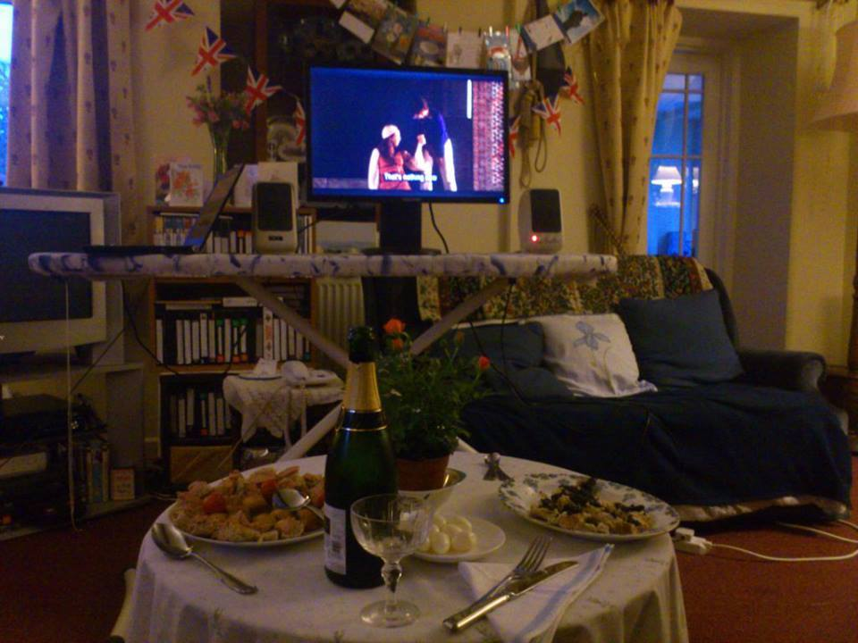

Slide 6
    Enriching the audience experience (live or online)

Slide 7
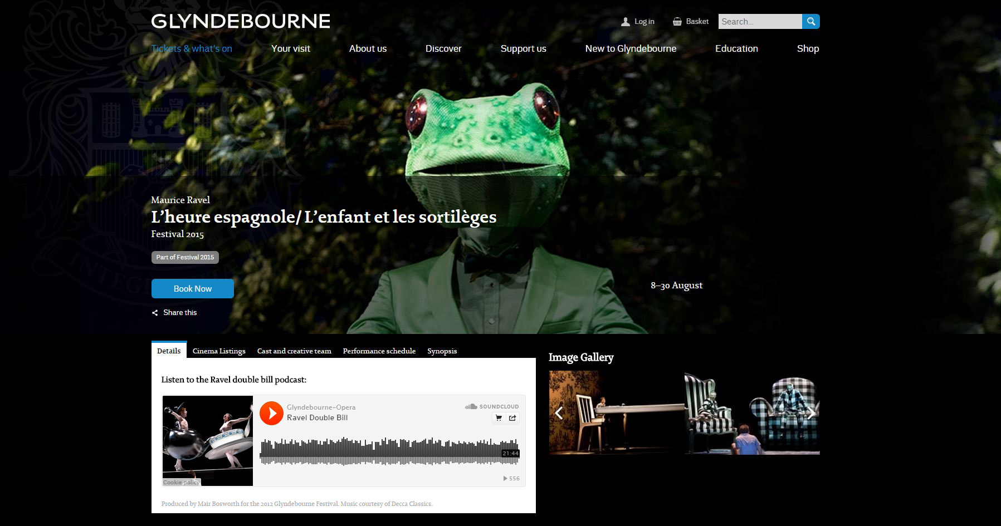

Slide 8
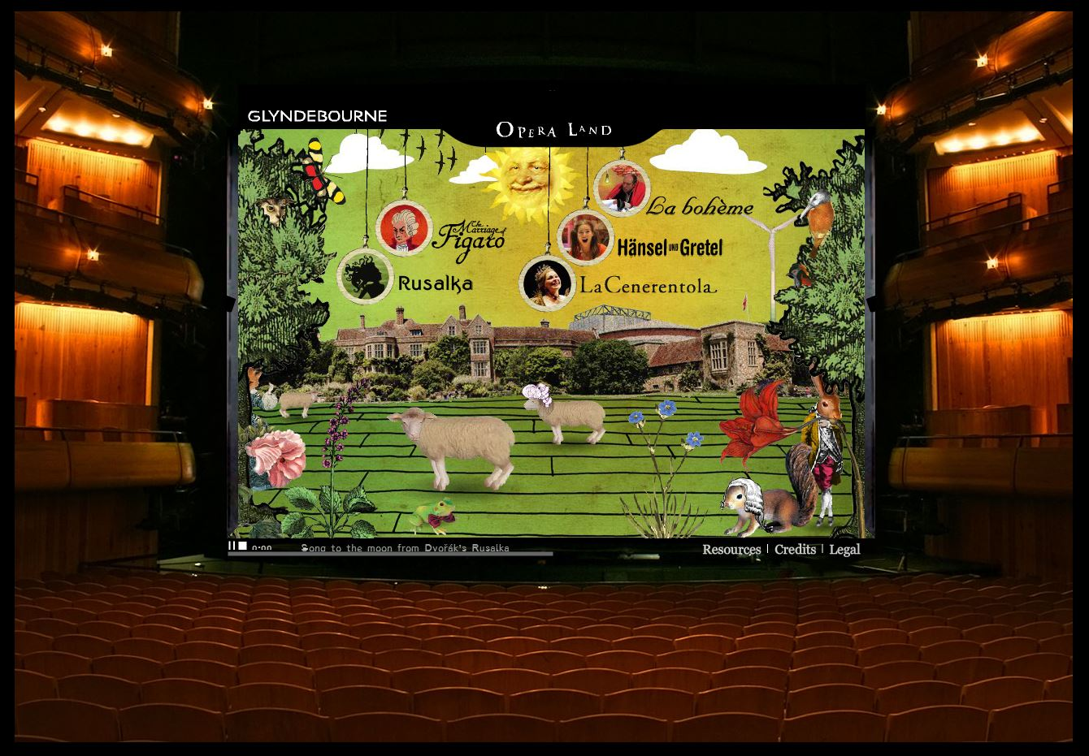

Slide 9
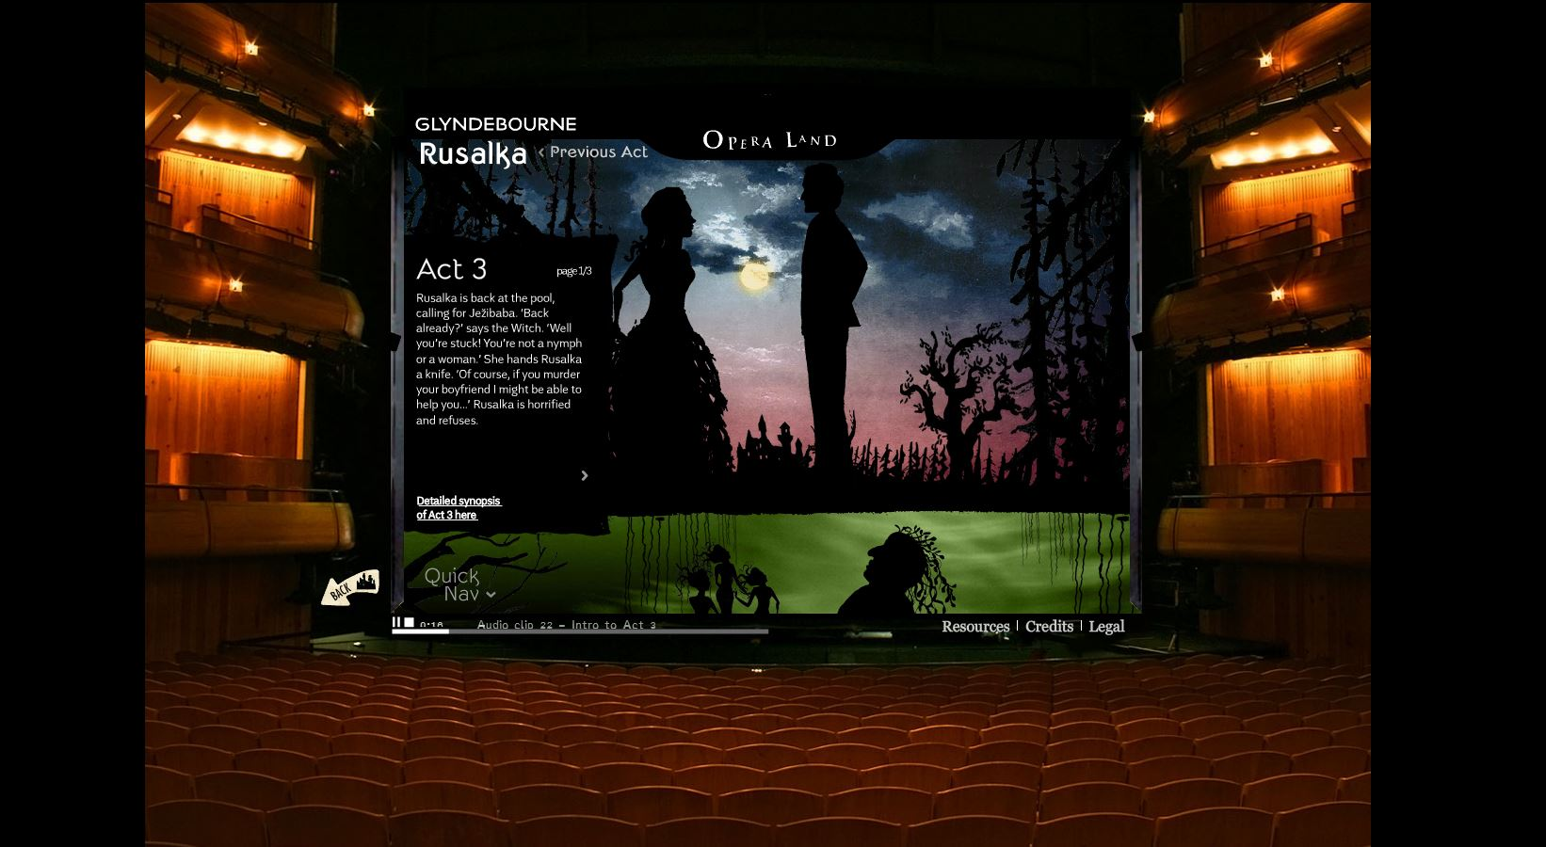

Slide 10
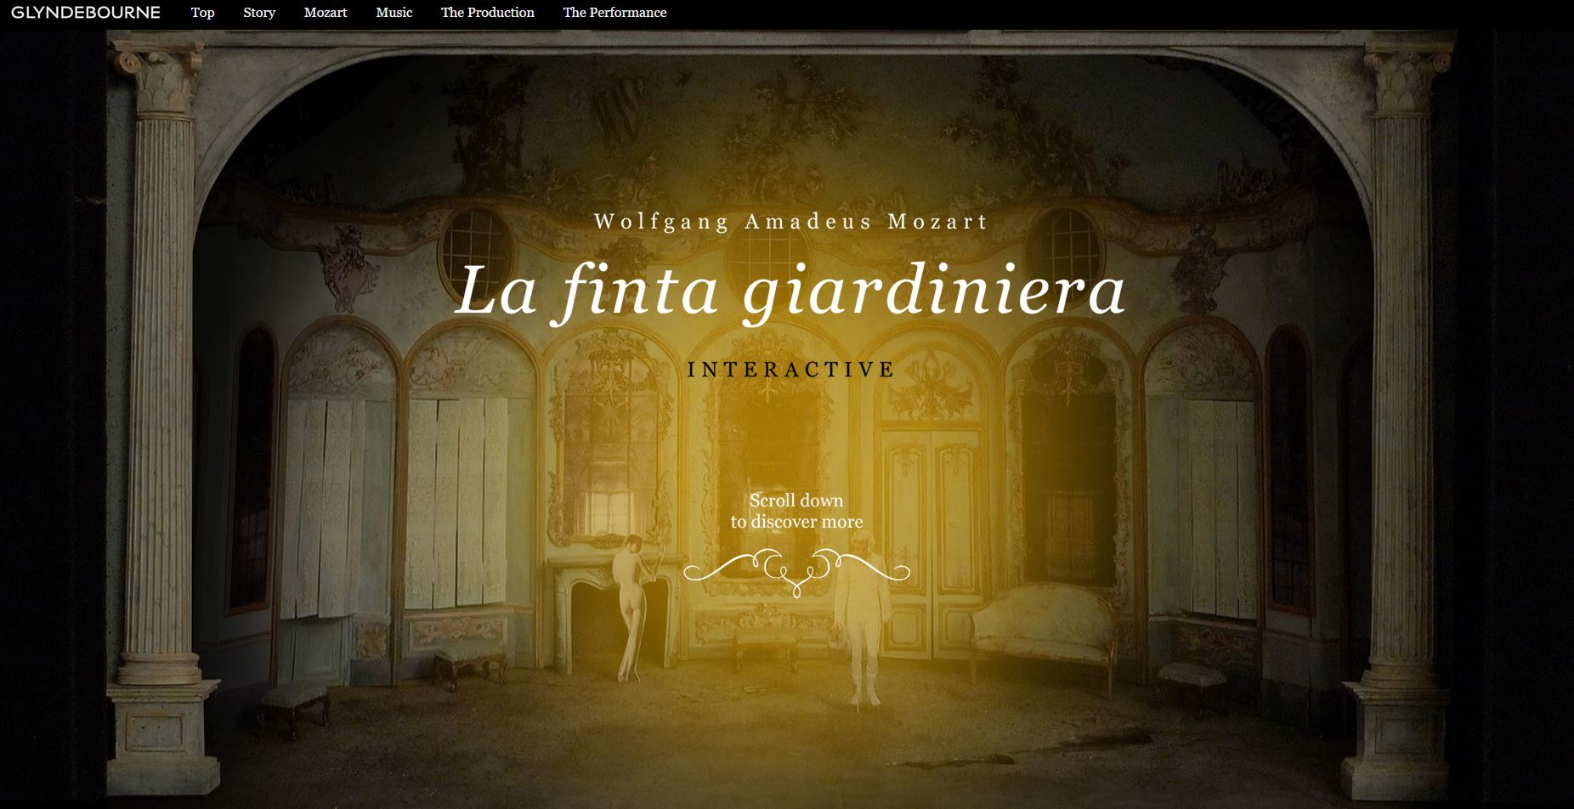

Slide 11
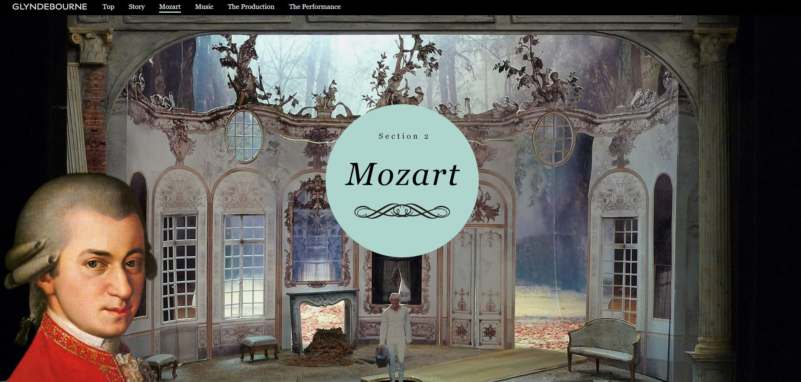

Slide 12
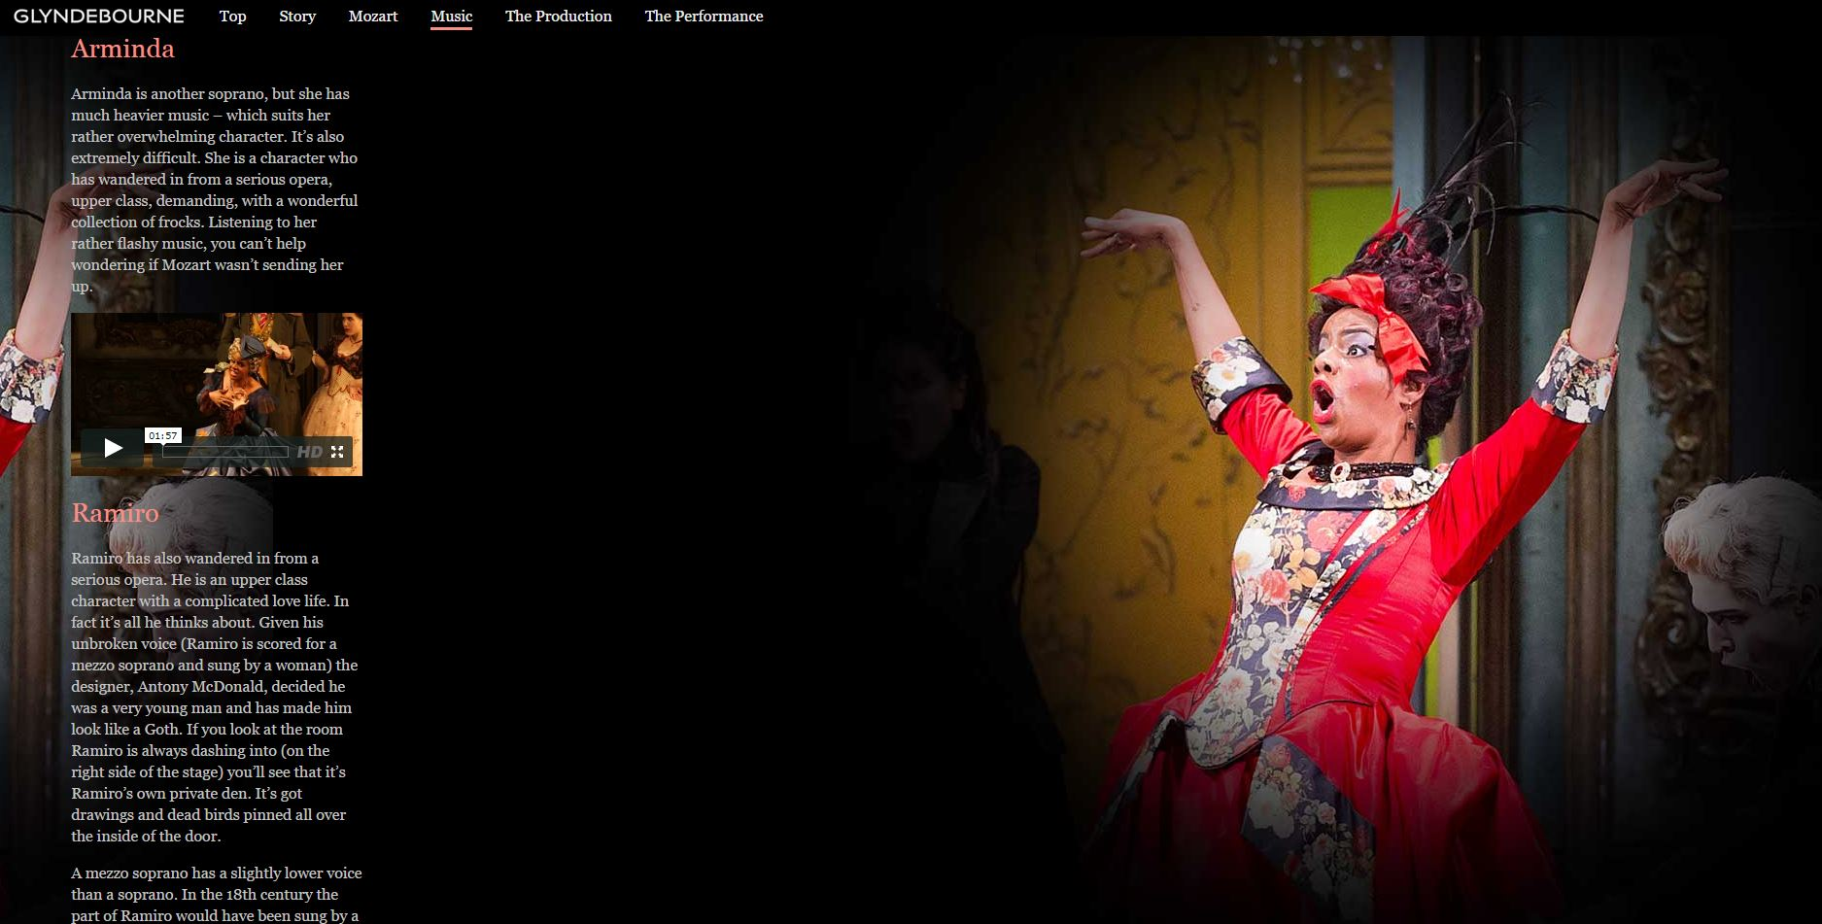

Slide 13
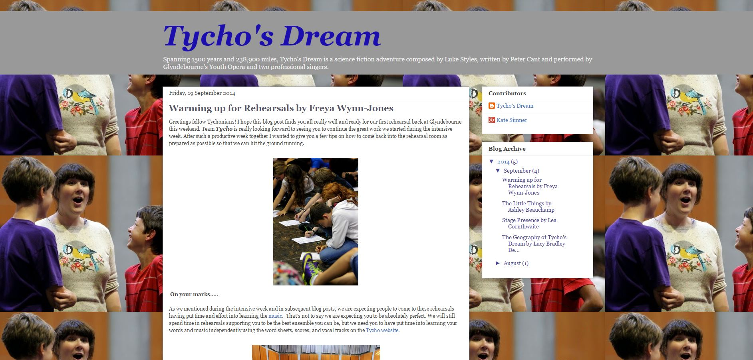

Slide 14
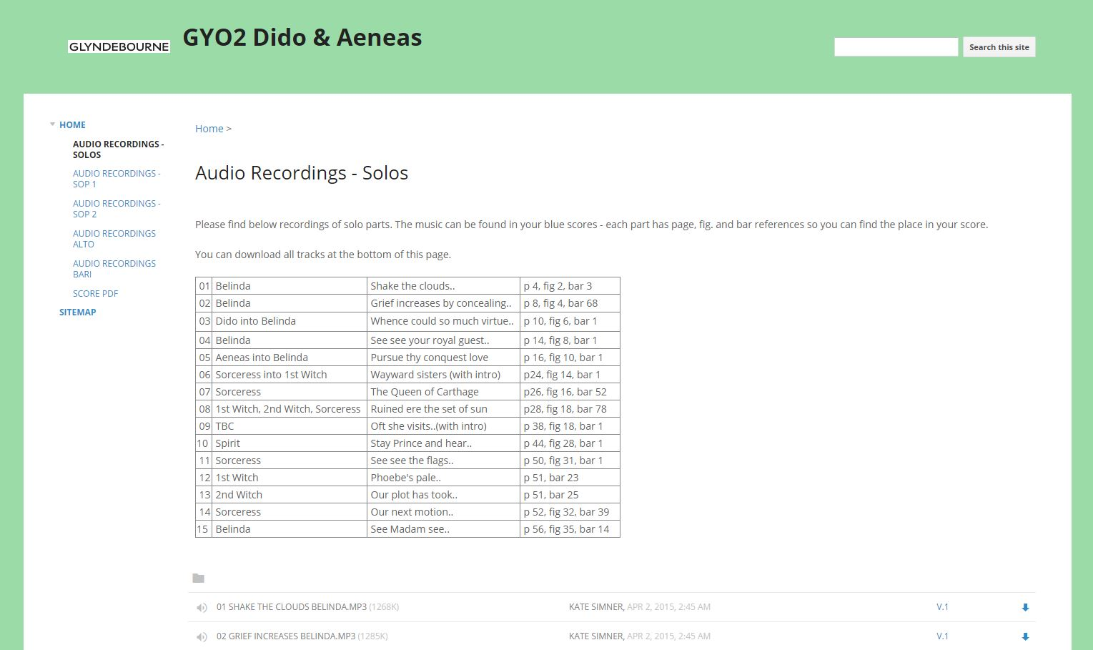

Slide 15
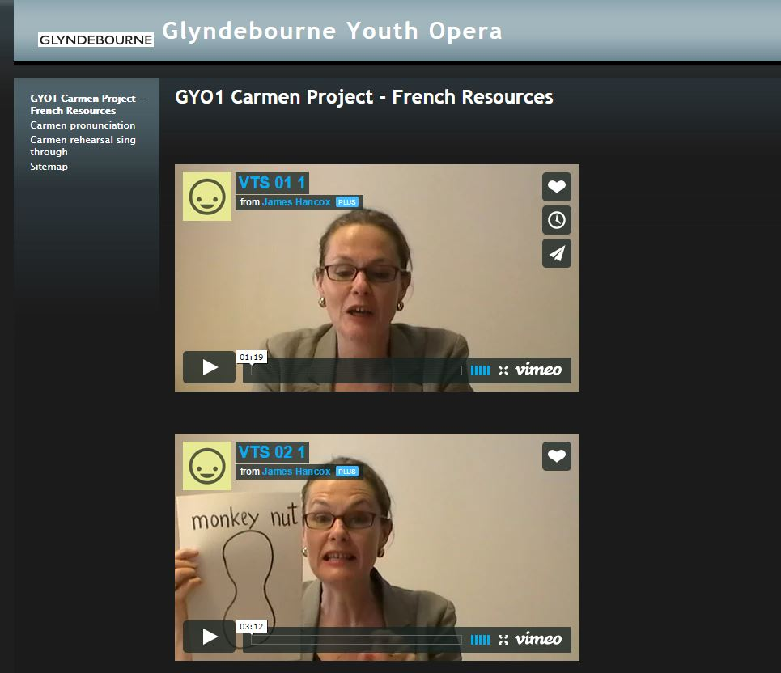

Slide 16
    c) Pushing the boundaries of the art form

Slide 17
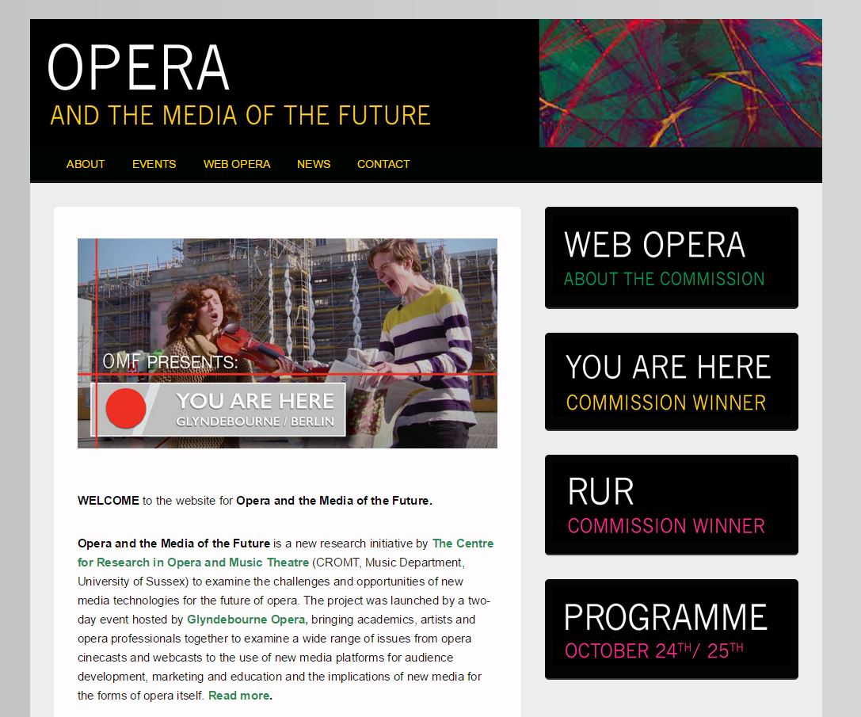
Notes:
Shakespeare project in 2016 – Integrated technology challenging our art form, how it’s constructed, received and understood. Young Composer in Residence

Slide 18
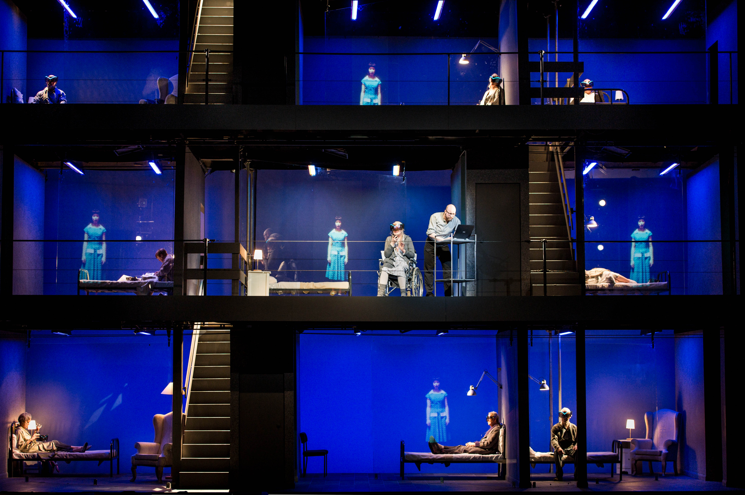

Slide 19
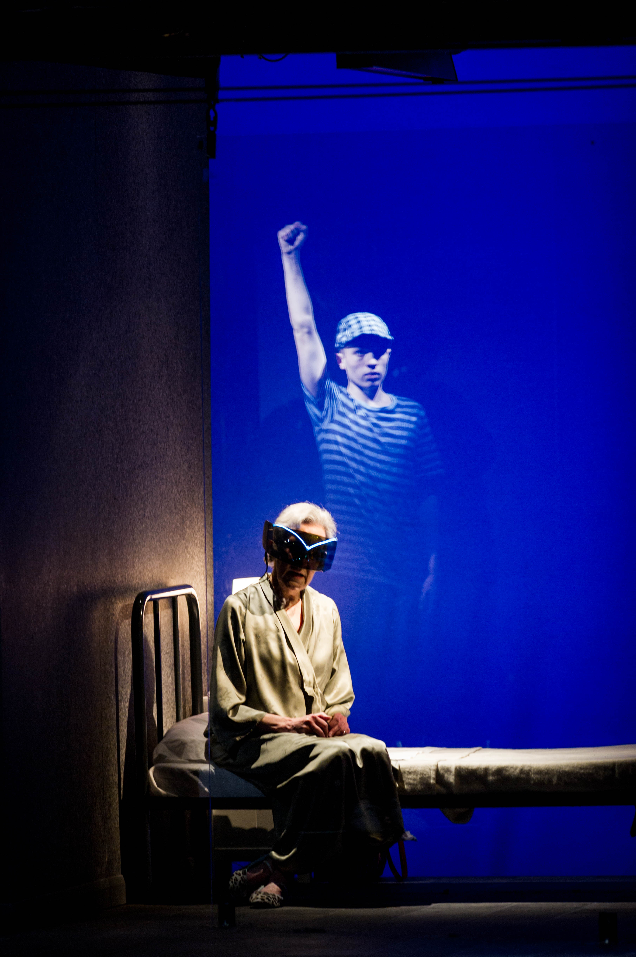

Slide 20
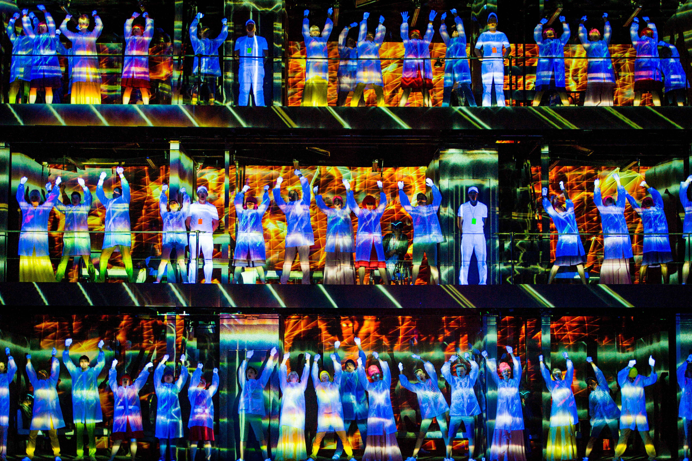

Slide 21


